Slide 1
Team 6 Final Project

Slide 2
Team Members
Tomas Samuolis
Devon Solheim
Kristen Bestavros
Noga Starobinski
Project Lead
Data Engineer
Co-Project Manager
Oghenerukevwe Omusi
Data Engineer
Co-Project Manager
Data Analyst Co-Project Manager
Sara Patel
Data Analyst
Data Engineer

Slide 3


Our Metrics
Public Information Campaigns
Workplace Closing
Level 0 - No COVID-19 public information campaign
Level 2: Require closing (or work from home) for some sectors or categories of workers
Level 3: Require closing (or work from home) for all-but-essential workplaces (i.e. grocery stores, doctors)

Slide 4
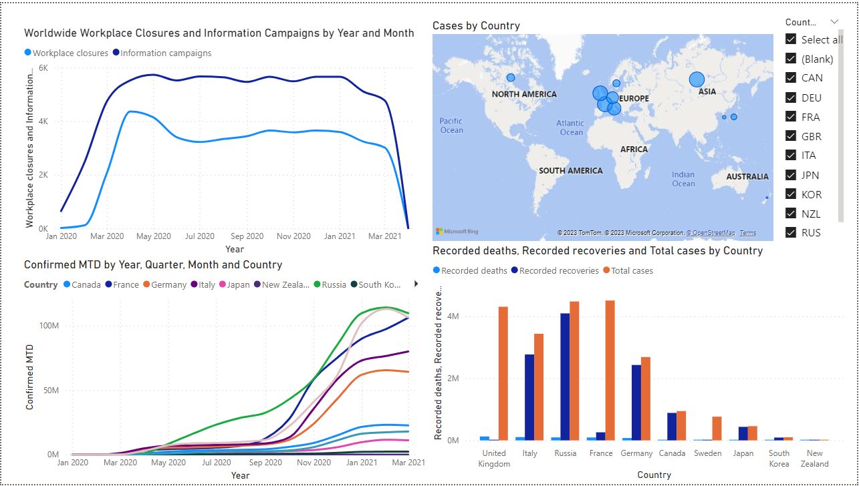
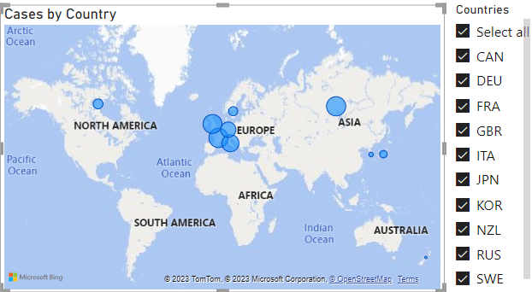
Baseline Stats

Slide 5
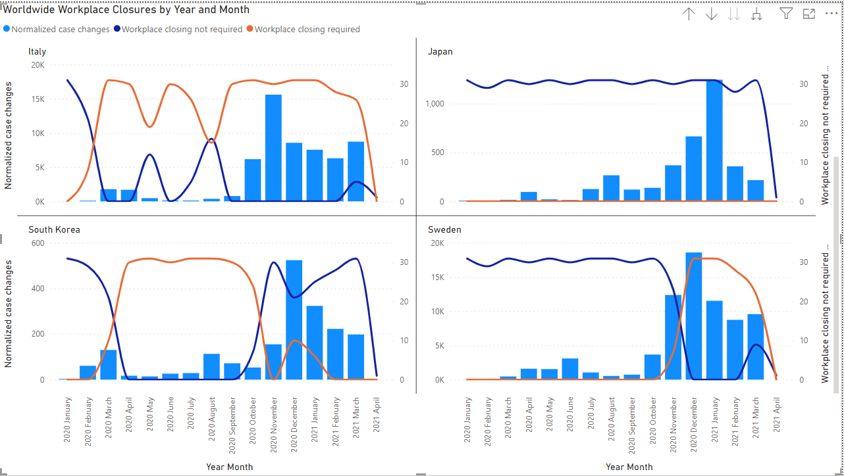
Workplace CLosing

Slide 6
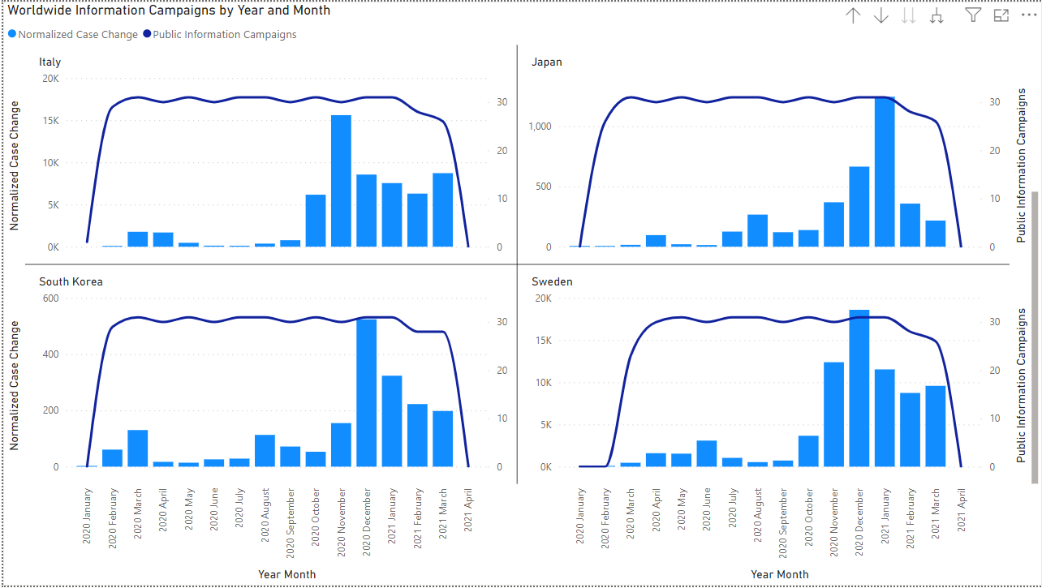
Public Information Campaigns

Slide 7
Challenges
Structuring
Dataflow
Cleaning and Understanding Data
Interpreting Results
Difficulty with organizing the different dimensions of the datasets without a clear understanding of the dataflow structure
The datasets contained a lot of noise and unusable information. We had to be cautious when deciding what data to use.
Comparing policies and their impacts was time consuming

Slide 8
Our Recommendation:
Best Policies to Implement
Policy 1
Policy 2
Immediately implement coordinated public information campaign at first signs of virus
Implement workplace closures when cases are high

Slide 9
Conclusion
Policies dictate how people view COVID-19 and adjust their lifestyles to avoid it
Implementing effective policies can be powerful in reducing the stress placed on healthcare facilities and reducing death count

Slide 10
Thank You!

